Slide 1
GUIs: Graphical User Interfaces
Chris Walshaw
Computing & Information Systems
University of Greenwich

Slide 2
Lecture Objectives
Today we are looking at GUI programming
tkinter and the grid manager
a variety of GUI features: labels, text fields, buttons, check boxes, combo boxes, radio buttons, …
using callback functions to interact with the user
We will also touch on
efficient programming
responsive design

Slide 3
Motivation
Our programs so far mostly have a text-based user interface
a bit clunky and hard to work with
Graphical user interfaces (GUIs) give the user a window containing visual objects often known as widgets, e.g.
text fields into which user can type in data
buttons that initiate actions
check boxes to set preferences
radio buttons or combo boxes to select options
etc
Typically GUIs are much easier to use

Slide 4
tkinter
GUI programming in Python is often done using the tkinter module
shipped with Python so nothing extra to install
tk is a cross-platform widget toolkit that provides a library of basic GUI elements for many programming languages
tkinter is short for tk interface
We will work through a series of examples introducing different widgets
Then build a GUI for choosing your favourite pizza and extra toppings
First we need to create a GUI window

Slide 5
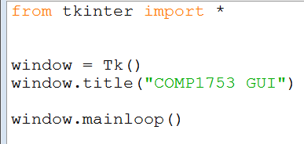
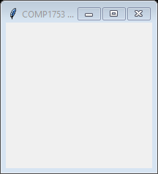
01GUI_window
Example 1 creates a window with a title
you need to call .mainloop() or the window won’t appear

Slide 6
Labels
About the most basic widget is a label
just contains some text, although it could also contain an image as well
Typically to add widgets we create a variable containing the widget
lbl = Label(window, text="Hello")
Then we position it in the GUI, here using the grid
lbl.grid(column=0, row=0)
In GUI programming it’s common to abbreviate variable names, e.g. lbl = label, btn = button, etc

Slide 7
Geometry Managers
Tkinter provides 3 geometry managers which you can use to position widgets in the GUI window
grid
pack
place
Here we will use the grid geometry manager
easy to learn
produces nice layouts

Slide 8
Tkinter grid
The tkinter grid is an imaginary rectangle consisting of cells
each cell is identified by its row and column number (starting from 0), e.g. row=2, column=1
The window layout is created by placing widgets into the cells
a widget can be inserted into an individual cell
or can span consecutive rows or columns
Each row and column expands to fit the largest widget in that row and column
so rows and columns are not all equally spaced

Slide 9
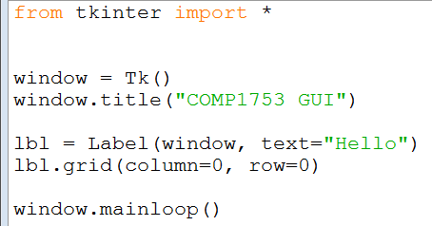

02GUI_label
Example 2 shows how to include a label

Slide 10
Sizing
Our window is getting smaller
because the row shrinks to fit the widget height
Of course tkinter provides lots of options for changing size including
setting the window size
setting the font size for text
setting the height and width of a widget
creating padding around each widget to separate them out
Mostly we won’t bother with these, but the next example demonstrates a couple

Slide 11
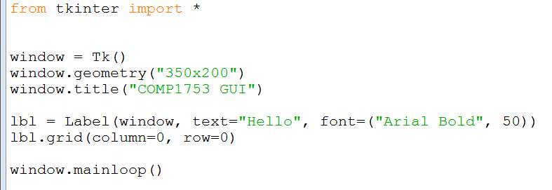
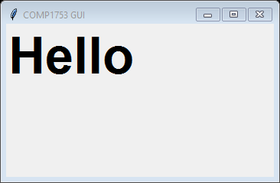
03GUI_sizing
Example 3 shows how to set the window size and font size of a label

Slide 12
Buttons
Buttons are common on GUIs and easy to implement
In the next example we have two widgets, a button and a label
need to make sure that the cell locations are different or they will appear one on top of the other
also includes a variant (commented out) for setting the foreground / background colours of the button
Currently the button does nothing when clicked

Slide 13
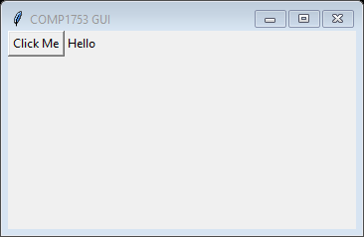
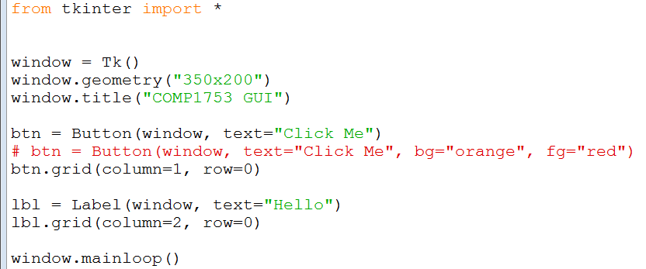
04GUI_button
Example 4 shows the two widgets
notice that as there is nothing in column 0, it shrinks to have zero width

Slide 14
Getting a response
Of course we want our GUI to do something when the button is clicked
The normal way to do this is to provide a function, attached to the button, which interacts other parts of the GUI program
NB the same is true for most programming languages (not just Python)
In the next example the function just changes the text of the label
This type of function is often known as a callback function
because the library code that implements the button uses the function to call back into our code (which it knows nothing about)

Slide 15
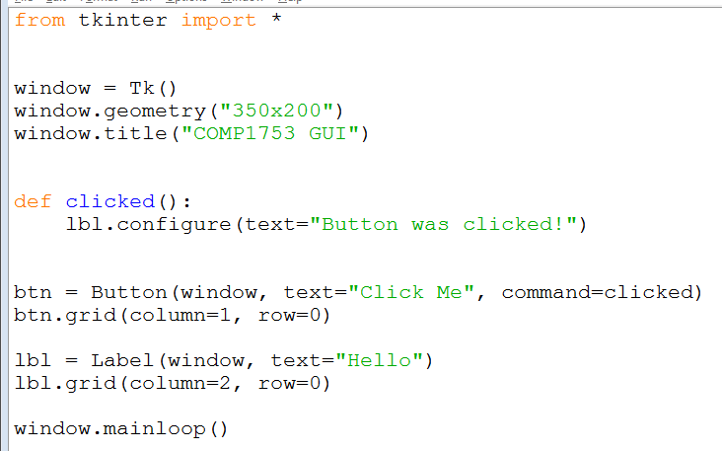
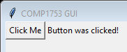
05GUI_buttonResponse
Example 5 shows how this works
NB usually we put functions at the top of the program
but here we put it close to where the button is created
the callback function, clicked()
the function is attached (bound) to the button when it is created

Slide 16
Text fields (Entry widget)
Another very common widget for GUI programming is the text field
known in tkinter as the Entry widget
Can easily get the text the user has typed in using the .get() method
The next example demonstrates typical usage
a text field for the user to enter some data
a button to tell the GUI to process the data
a widget (in this case a label) for the GUI to output the results of the processing

Slide 17
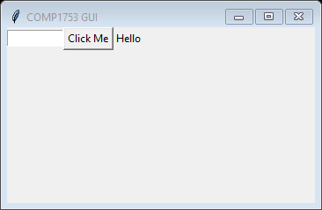
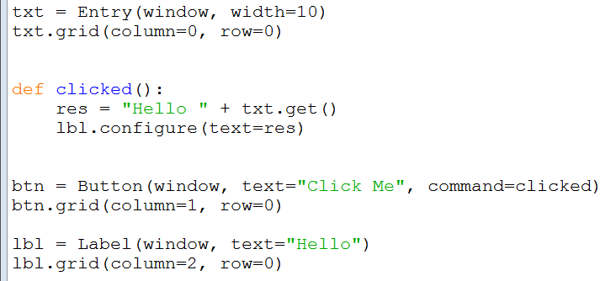
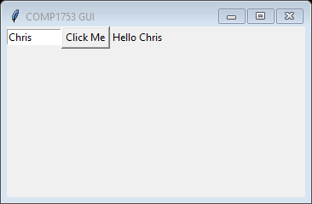
06GUI_entry
Example 6 shows how this works
the image below just shows the text field, button and label

Slide 18
Writing to a text field
It is not very sophisticated to communicate with the user through labels – better to use text fields
However, it is harder to set the contents of a text field – the next example shows how to do it
create a special variable which is bound to the text field
in this case the variable is a StringVar (defined in the tkinter module)
use the .set() method of the StringVar to update this variable
the text field automatically displays whatever is stored in the StringVar
This is a common approach in tkinter
we will see it used for other widgets with other types of special variable

Slide 19
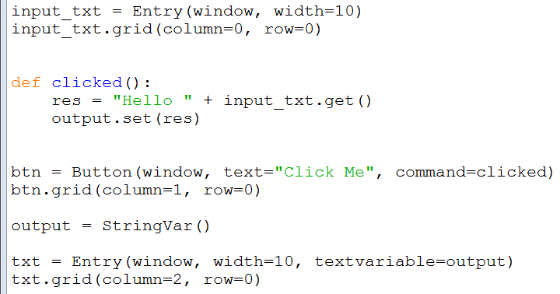
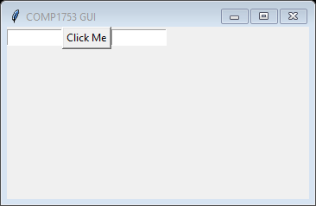
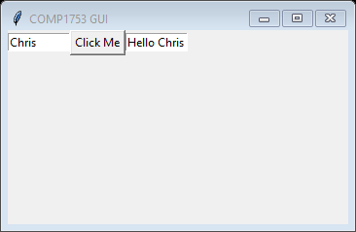
07GUI_entryResponse
Example 7 shows how this works
output is set when the button is clicked
the StringVar is called output
output is bound to the text field

Slide 20
Finessing
The next example makes a couple of minor improvements to enhance the user experience
The focus is automatically set to the input text field when the GUI starts up
so the user doesn’t need to click on it to start typing
The output text field is set to be “read-only”
gives the user a visual indication that it’s for output
stops the user from trying to type into it

Slide 21
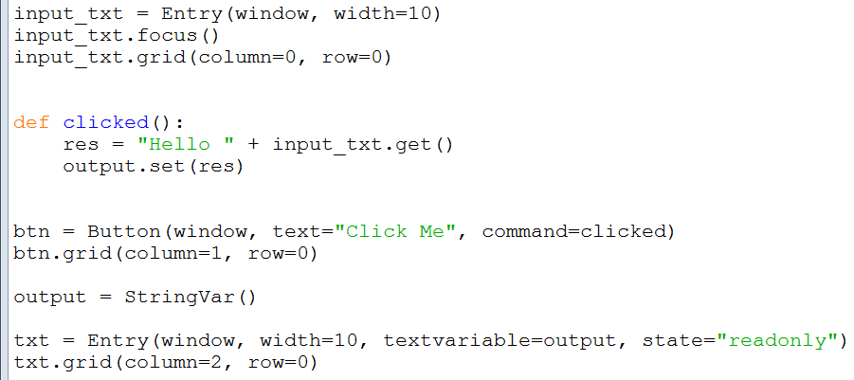

08GUI_focus
Example 8 shows how to do both
focus set to the input text field
output text field set to read-only

Slide 22
Check boxes
Check boxes are common way of setting preferences or acknowledging something
To set them we employ the same idea as writing to a text field
a special variable, bound to the check box
However a check box can only be in one of two states: checked and unchecked
so we use a BooleanVar (defined in tkinter)

Slide 23
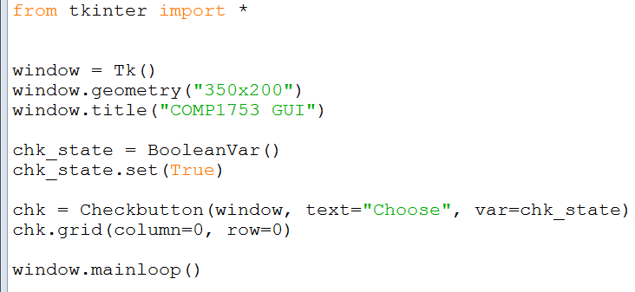
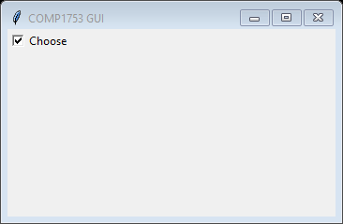
09GUI_checkbox
Example 9 shows the code for including and setting a check box

Slide 24
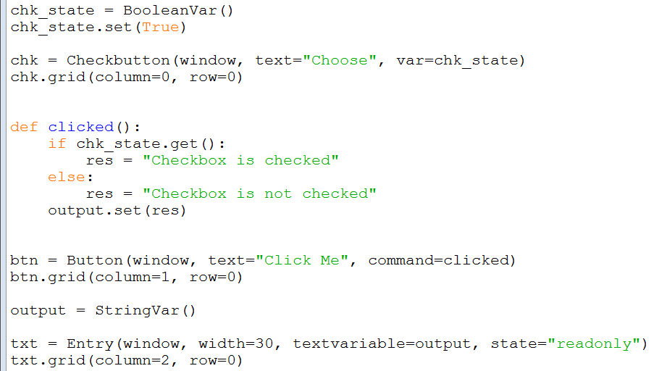
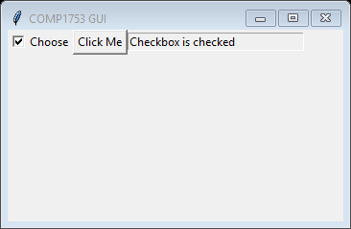
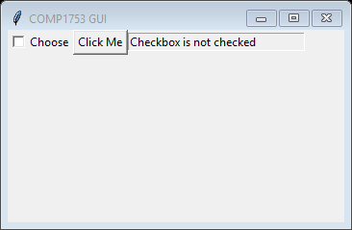
10GUI_checkboxResponse
Example 10 shows an interactive version
with a button and text field

Slide 25
Combo boxes
Combo boxes are a good way for the user to choose an option from a list of many
also known as drop-down lists
Combo boxes are only available in the ttk module of tkinter
requires an extra import statement
includes “themed” versions of tk widgets
supposedly with a better cross-platform look and feel
Can set a list of values which will appear in the drop-down list

Slide 26
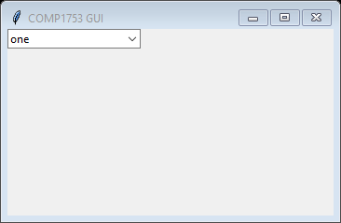
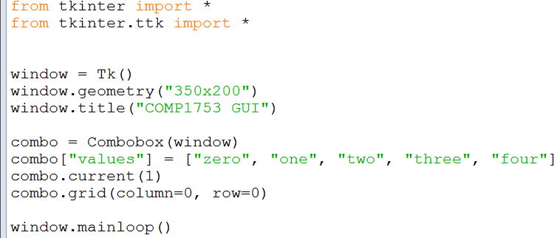
11GUI_combobox
Example 11 shows a combo box
values in the drop-down list

Slide 27
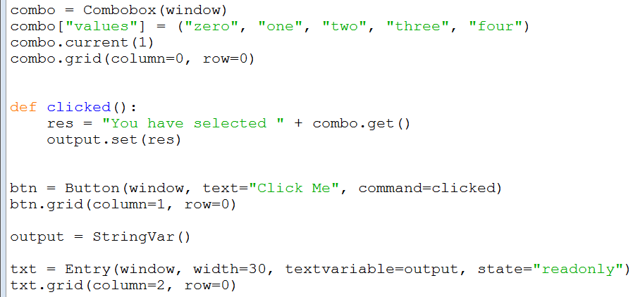
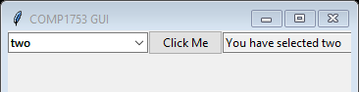
12GUI_comboboxResponse
Example 12 shows an interactive version
notice the ttk button and text field look slightly different

Slide 28
Radio buttons
Combo boxes are a good option if there is a long list of options (say 5 or more)
However, if the list is relatively short radio buttons are considered more user friendly
like the buttons on an old radio – only one can be selected at a time
Once again we use a special variable bound to all the radio buttons
since there are usually several radio buttons and we want to know which is pressed, we use an integer IntVar
The buttons are “controlled” by this IntVar
if one button is selected, then all the others are deselected

Slide 29
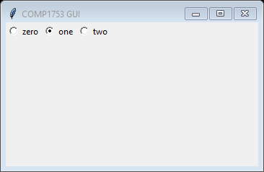
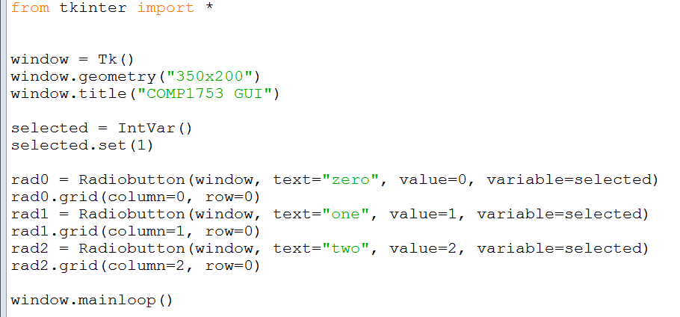
13GUI_radiobutton
Example 13 shows how to create a group of radio buttons

Slide 30
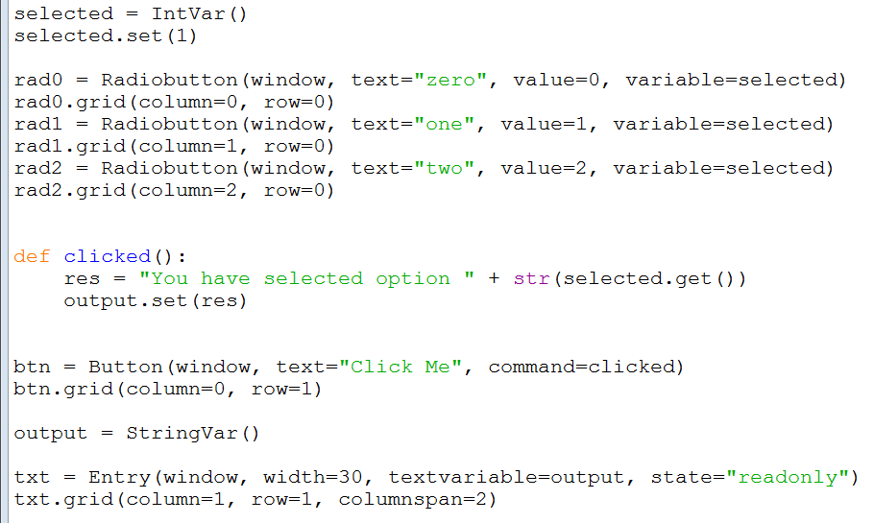
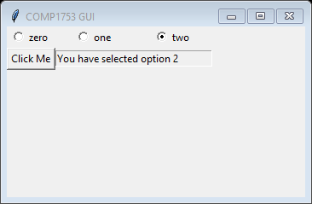
14GUI_radiobuttonResponse
Example 14 shows the interactive version
note – this is the 2nd row
also the text field spans 2 columns

Slide 31
Think like a programmer!
As soon as you see variables labelled rad0, rad1, rad2, etc you should be thinking
Could we do that with a list and a loop?
especially if all the variables are essentially storing the same thing (in this case, a radio button)
The answer in this case is yes
makes the code as efficient as possible – more concise and less error-prone
also means that it is easy to add extra options

Slide 32
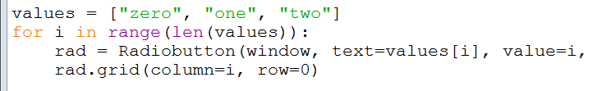
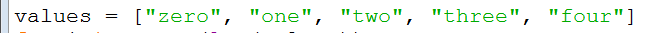
15GUI_radiobuttonList
Example 15 shows this
the radio button initialisations can replaced
everything else stays the same
Now it is super easy to add extra options

Slide 33
Pizzas
We will now employ all our GUI widgets to build a pizza app that lets the user choose and configure a pizza
we won’t spend too long on the details but you should review the code in your own time
We start by designing the layout
at this point it’s probably only worth including a few options just to check everything works
initially the button does nothing other than set the text in the output text field to a dummy value
Notice that every widget is on a new row
also notice the sticky="W" setting which justifies the widget to the left-hand (West) side of its cell

Slide 34
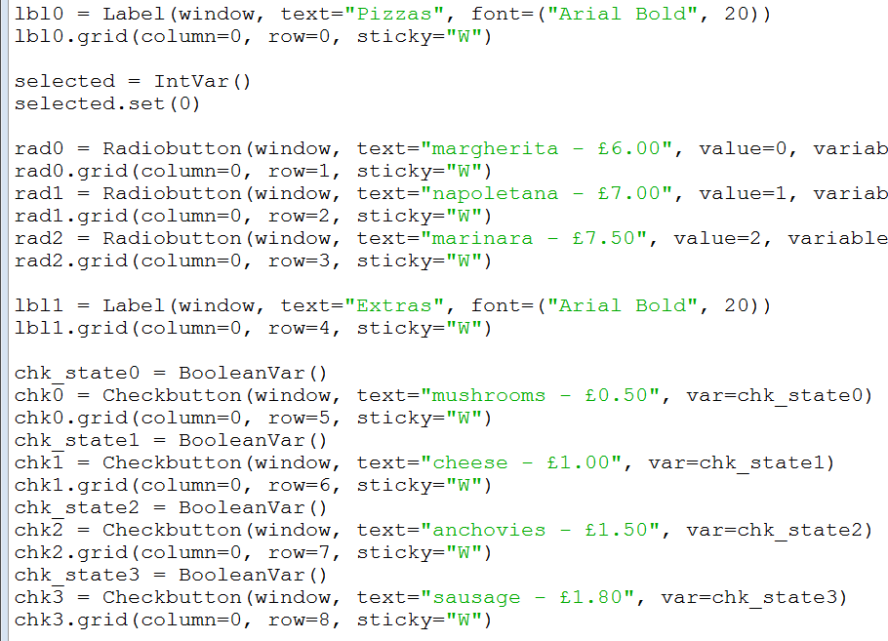
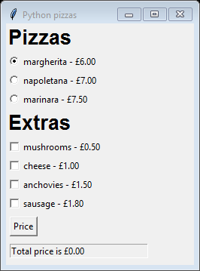
16Pizza_design
Example 16 shows the initial design

Slide 35
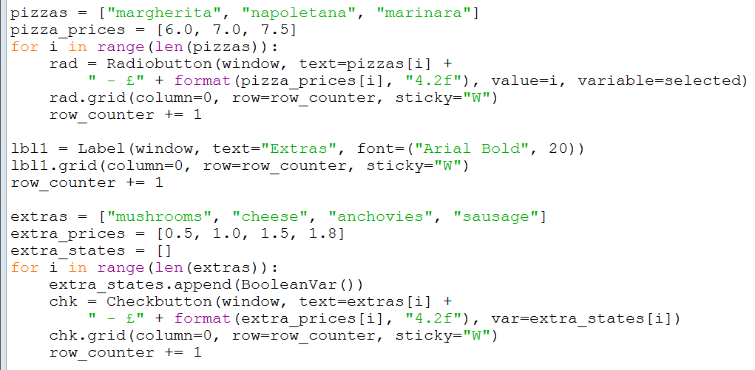
17Pizza_lists
Example 17 replaces all those variables with 4 lists of data and 2 loops
pizza & pizza prices data
extras & extra prices data

Slide 36
Calculating the price
Now everything is stored in an array it is relatively easy to calculate the price
work out which item of the pizzas list is selected and look up the corresponding price in the pizza_prices list
similar process for extras, although more than one extra can be selected
We also construct a message with the details of the pizza ordered
to send to the chef!

Slide 37
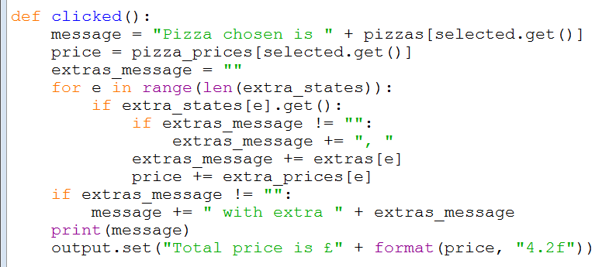
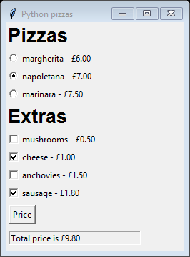
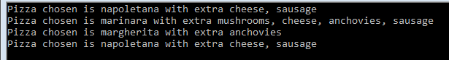
18Pizza_price
Example 18 shows how this is done
the only changes are in the clicked() function
base price
loop over extras
if extra selected
add to message
add in the cost

Slide 38
Responsive design
There’s currently some redundancy in our design
the user selects the pizza (radio button) and chooses some extras (check boxes)
then they have to click the “Price” button
Instead the GUI could react by calculating the price every time one of the radio buttons or check boxes is changed
this is known as responsive design
In fact it’s remarkably easy to achieve
just bind the clicked() function to every radio button and check box
the same way it is currently bound to the “Price” button
once this is done the “Price” button is completely redundant and can be removed

Slide 39
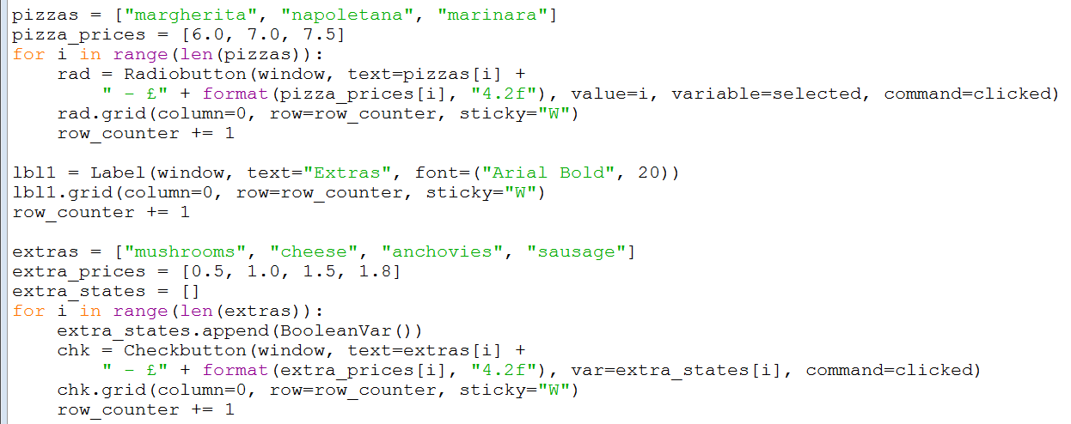
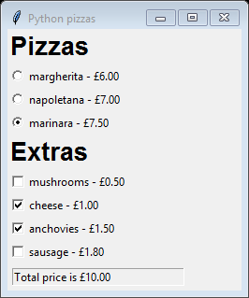
19Pizza_responsive
Example 19 features the new responsive design
the clicked() function is bound to each radio button …
… and to each check box

Slide 40
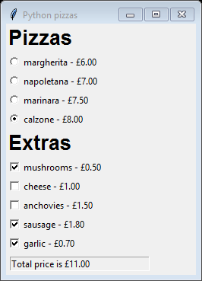
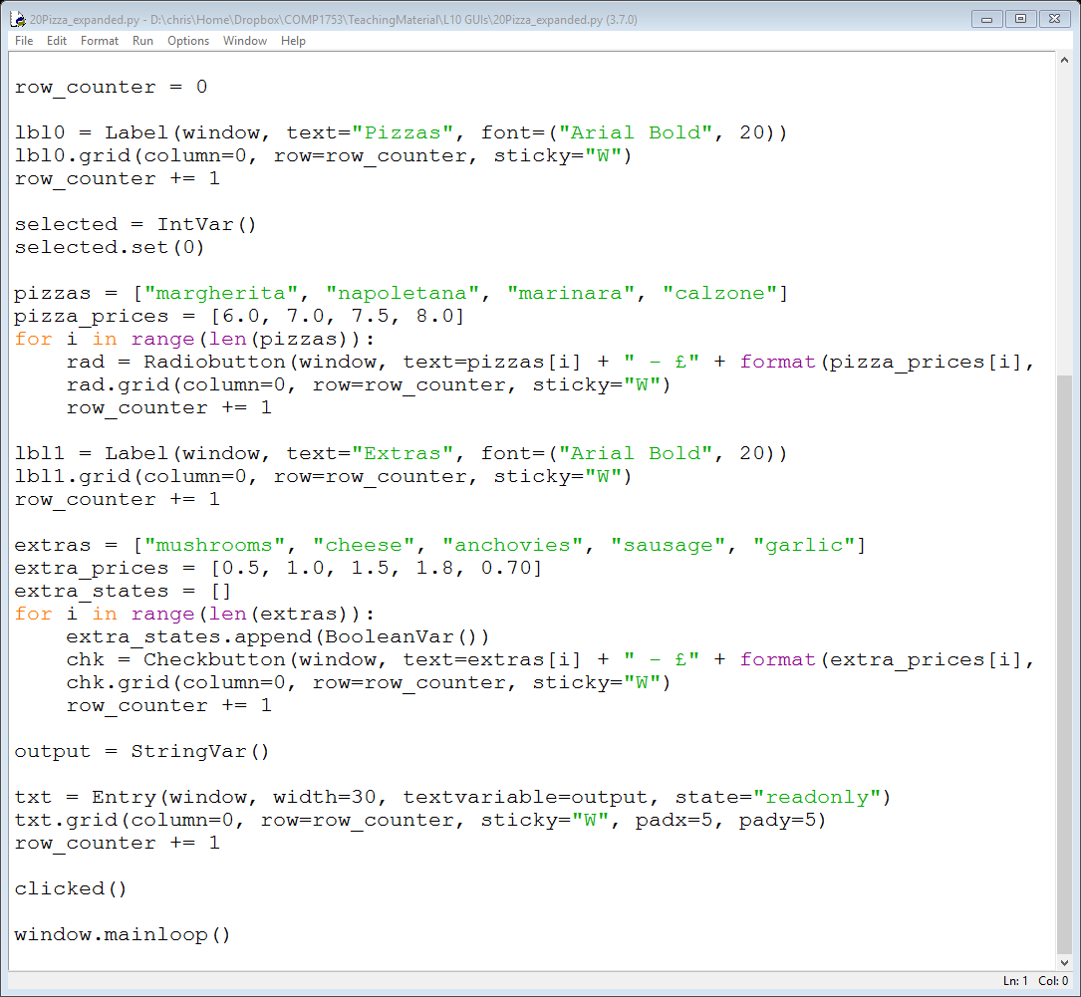
20Pizza_expanded
Now that the design is completed it is extremely easy to add extra options for our customers
just make sure that the length of the pizzas list matches the pizza_prices
and similarly for the extras and extra_prices

Slide 41
Summary
Today we looked at GUI programming
the tkinter grid manager
a variety of widgets
using callback functions to interact with the user
We also touched on
efficient programming
responsive design
Obviously there is far more to good GUI design but this gives you some basics

